Slide 1

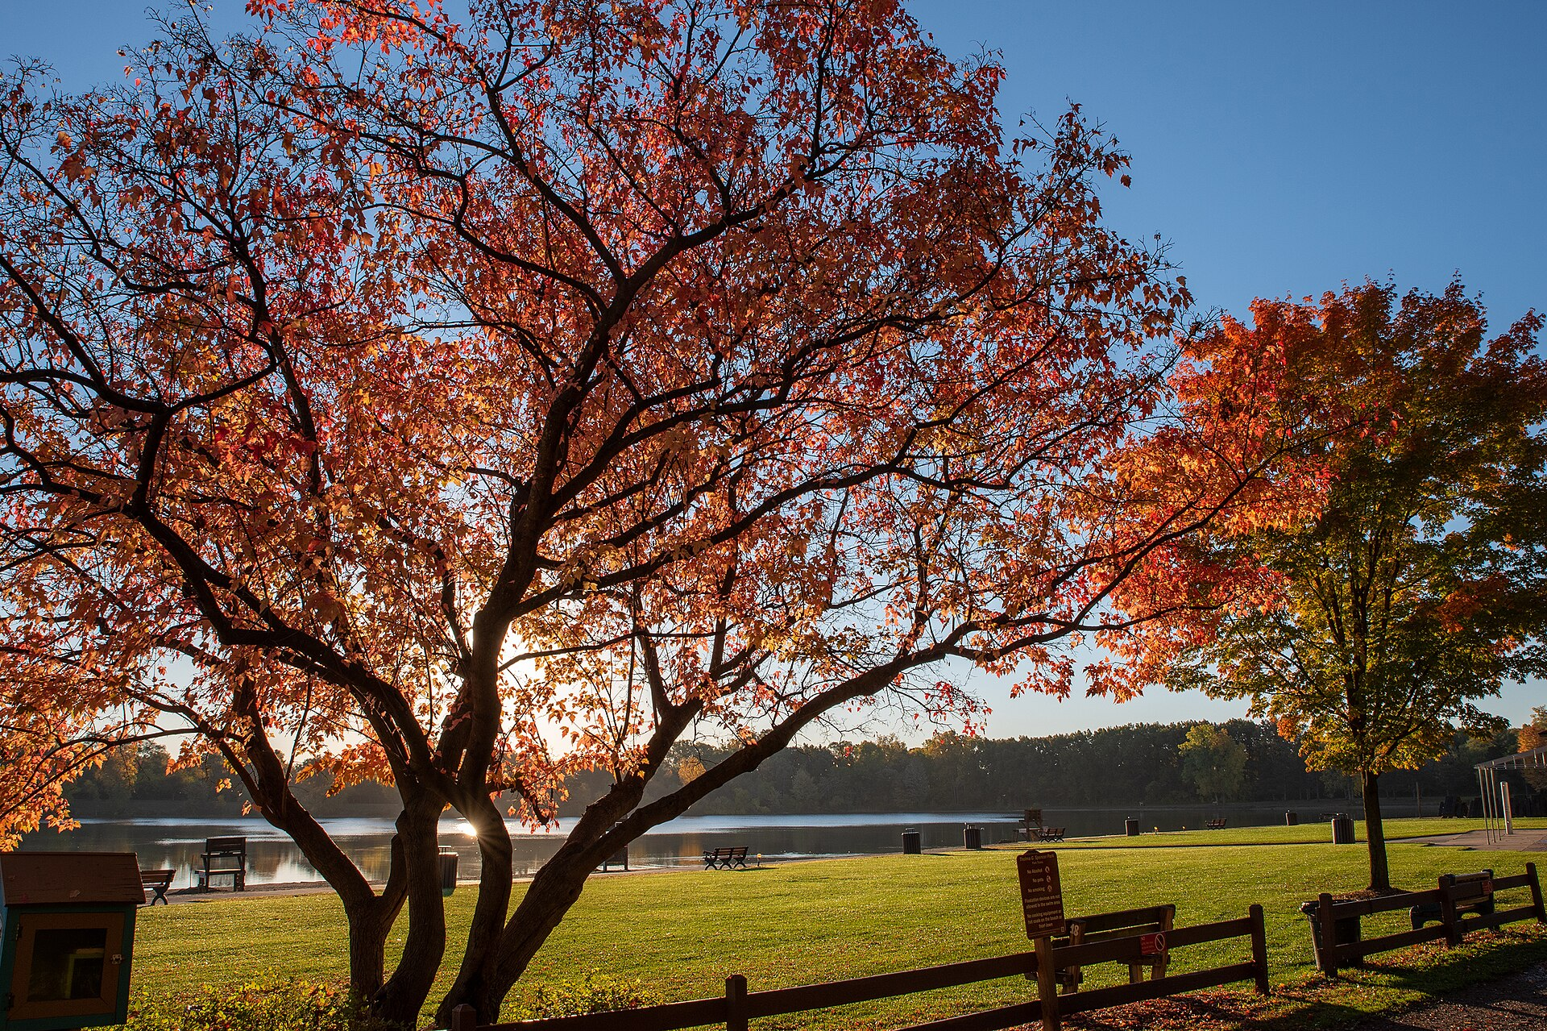
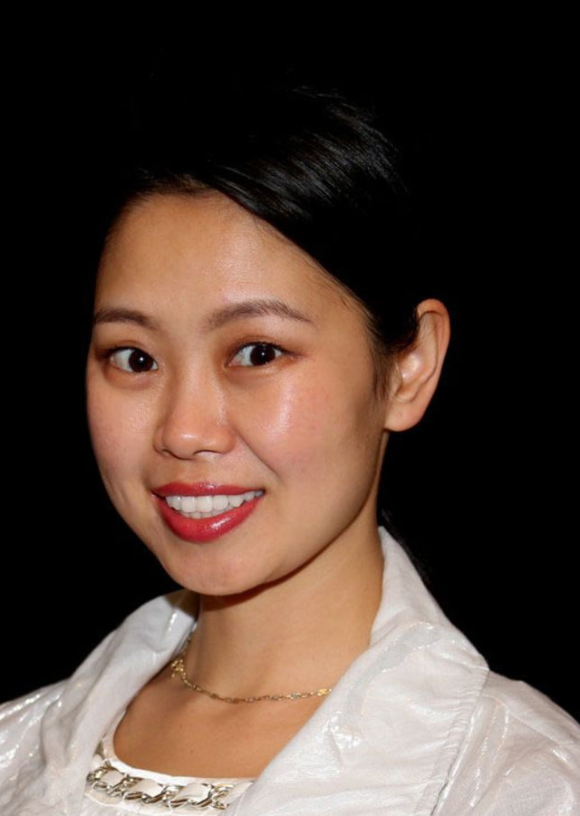
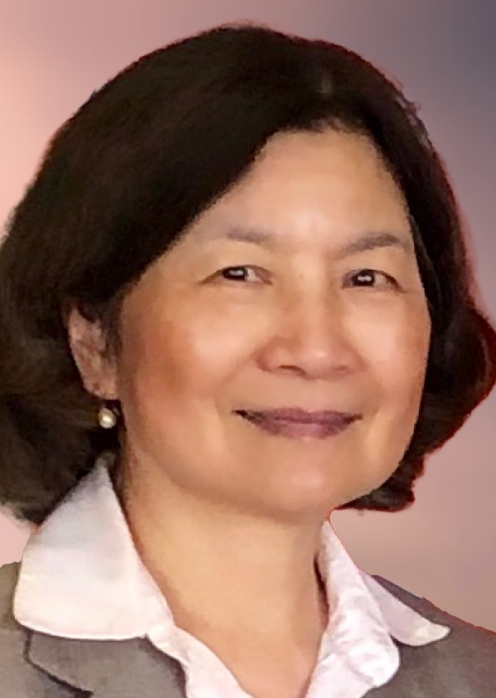
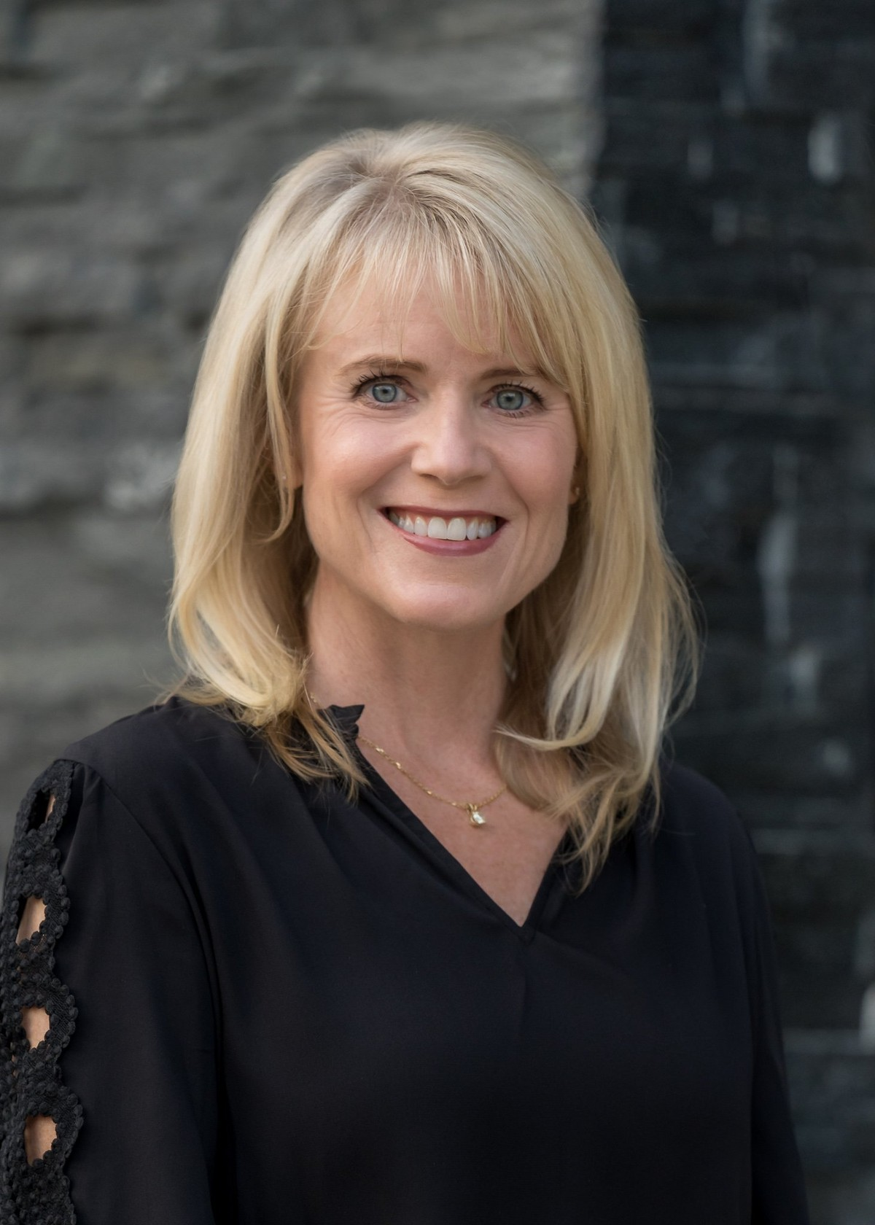
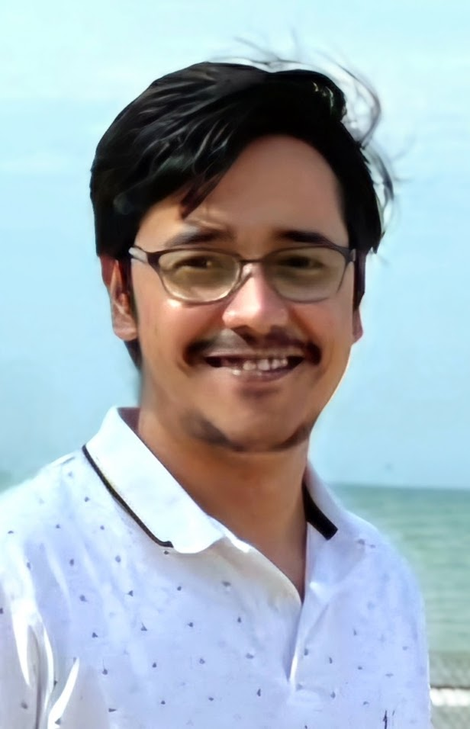
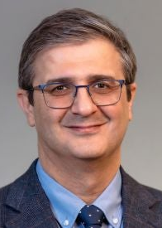
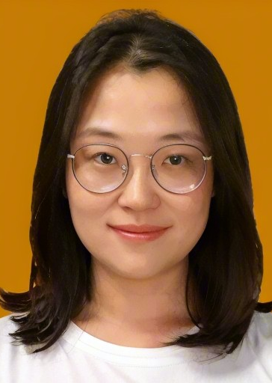
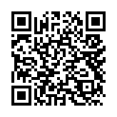
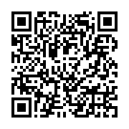
FREE PUBLIC EVENT
TEDxAuburnHills
x = independently organized TED event
Retooling
Same hands, different tools.
Ideas shaped here.
SATURDAY · OCT 10 · 2026
11:00 a.m.–3:00 p.m. · Eastern
TEDxAuburnHills • OCTOBER 10, 2026
What to expect
About the theme
Eight live talks
Live performances
100 in-person guests
Intermission refreshments
Live captions
Free livestream
Community networking
Two speakers still to come
Retooling begins with a simple recognition: the people doing the work may remain the same even when the methods around them must change. Tools can be physical, technical, social, or cultural. Join voices across disciplines to ask what deserves to be kept, what needs to be rebuilt, and what communities can create next.
Event timeline
Meet the speakers
10:45 a.m.
Kefei Duan, DDS
Janilla Lee, PhD
Check-in begins
Dentistry, trust, and
compassionate care.
Health advocacy, engineering,
and community service.
11:00 a.m.
Welcome and performance
11:10 a.m.
Shelly Propson Lennon
Amartya Sen, PhD
Speaker session one
Inclusive art, disability,
and community possibility.
Cybersecurity, secure systems,
and connected devices.
1:00 p.m.
Speaker session two
Ahmad Tafti, PhD
Kaiqi Zhao, PhD
2:10 p.m.
Explainable artificial intelligence
and health decisions.
Efficient AI, model compression,
and edge computing.
Community networking and photos
Attend in person
Scan to join
FREE
ADMISSION
Admission: free, registration required
Capacity: up to 100 in-person guests
Check-in: 10:45 a.m.
Venue: location to be announced
Food and drinks: available for purchase
Access: live captions and free livestream
EVENT
WEBSITE
FREE
REGISTRATION
100
SEATS
Notes:
[Sources]
- Template: C:/Users/Lyuwen Yan/Documents/TEDxAuburnHills/Example Poster.pptx
- Event theme, date, time, speakers, and public-event details: website/index.html, website/about.html, website/attend.html, website/schedule.html
- Website typography, palette, and wordmark treatment: website/static/css/index.css and website/static/js/index.js
- Body photo: website/assets/images/rochester-hills-spencer-park.jpg
- Speaker portraits: website/assets/images/*-official.jpg (six announced speakers)
- Top-right artwork: website/assets/images/flow-background.jpg
- QR codes: user-supplied PNG files in the workspace root
[/Sources]

